Slide 1
CST-104
Object Oriented
Programming In C++
Fourth Edition
Robert Lafore

Slide 2
Lecture Outline (2nd Semester)
Chapter 4 – Structures
Chapter 12 –Streams and Files
Chapter 5 – Functions
Chapter 6 – Object and Classes
Chapter 8 – Operator Overloading
Notes:
Programming
Basics of C++ Environment
C++ Program Construction
Variable & Data Types
Operators
Operators Precedence / Assignment
Selection Criteria
Looping
File
Array

Slide 3
CHAPTER 4 Structures

Slide 4
What is a structure?
A structure (called record) is a collection of simple variables. The variables in a structure can be of different types: Some can be int, some can be float, and so on.
The data items in a structure are called the members of the structure.

Slide 5
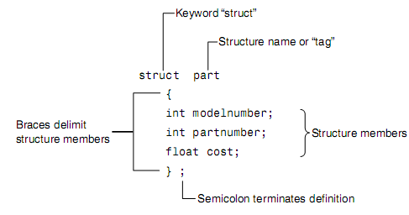
Syntax
1. Defining a structure
struct structure_name {
variable declarations;
};
Example:
semicolon
2. Declaration a structure variable
3. Accessing structure members

Slide 6
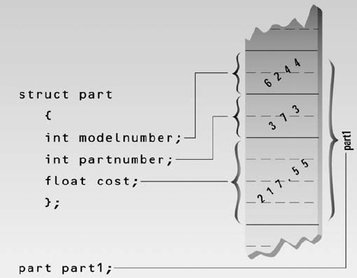
Structure Member in Memory

Slide 7
A Simple Structure
// Page 132 – 133// part.cpp
#include <iostream.h>
struct part //declare a structure
{
int modelnumber; //ID number of widget
int partnumber; //ID number of widget part
float cost; //cost of part
};
int main()
{
part part1; //define a structure variable
part1.modelnumber = 6244; //give values to structure members
part1.partnumber = 373;
part1.cost = 217.55F;
//display structure members
cout << “Model “ << part1.modelnumber;
cout << “, part “ << part1.partnumber;
cout << “, costs $” << part1.cost << endl;
return 0;
}
Output:
Model 6244, part 373, costs $217.55

Slide 8
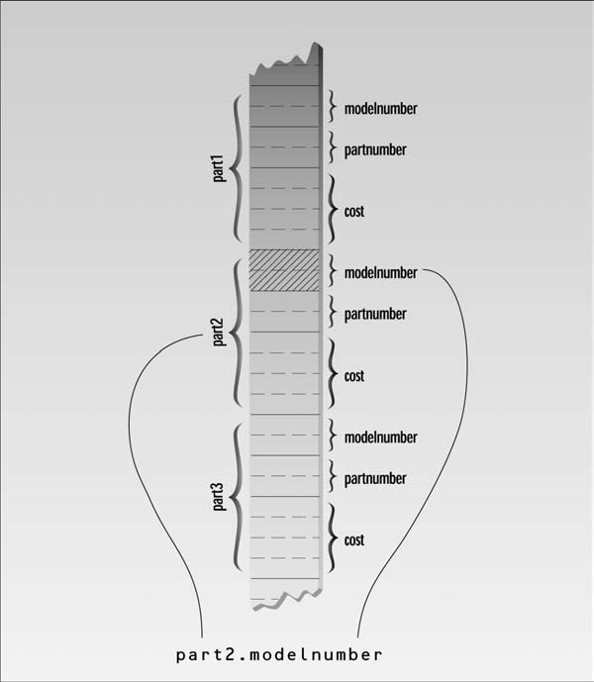
Accessing Structure Member

Slide 9
Initializing Structure Members
// Page 138//partinit.cpp
#include <iostream>
using namespace std;
struct part //specify a structure
{ int modelnumber; //ID number of widget
int partnumber; //ID number of widget part
float cost; //cost of part
};
int main()
{ //initialize variable
part part1 = { 6244, 373, 217.55F };
part part2; //define variable
//display first variable
cout << “Model “ << part1.modelnumber;
cout << “, part “ << part1.partnumber;
cout << “, costs $” << part1.cost << endl;
part2 = part1; //assign first variable to second
//display second variable
cout << “Model “ << part2.modelnumber;
cout << “, part “ << part2.partnumber;
cout << “, costs $” << part2.cost << endl;
return 0;
Here’s the output:
Model 6244, part 373, costs $217.55
Model 6244, part 373, costs $217.55

Slide 10
Initializing Structure Members
// Page 139 // englarea.cpp// demonstrates structures using English measurements
#include <iostream>
struct Distance //English distance
{ int feet;
float inches;};
int main()
{ Distance d1, d3; //define two lengths
Distance d2 = { 11, 6.25 }; //define & initialize one length
//get length d1 from user
cout << “\nEnter feet: “; cin >> d1.feet;
cout << “Enter inches: “; cin >> d1.inches;
//add lengths d1 and d2 to get d3
d3.inches = d1.inches + d2.inches; //add the inches
d3.feet = 0; //(for possible carry)
if(d3.inches >= 12.0) //if total exceeds 12.0,
{ //then decrease inches by 12.0
d3.inches -= 12.0; //and
d3.feet++; //increase feet by 1
} //display all lengths
d3.feet += d1.feet + d2.feet; //add the feet
cout << d1.feet << “\’-” << d1.inches << “\” + “;
cout << d2.feet << “\’-” << d2.inches << “\” = “;
cout << d3.feet << “\’-” << d3.inches << “\”\n”;
return 0;}
output:
Enter feet: 10
Enter inches: 6.75
10’-6.75” + 11’-6.25” = 22’-1”
Notes:
Notice that we can’t add the two distances with a program statement like
d3 = d1 + d2; // can’t do this in ENGLSTRC

Slide 11
Array of struture
// Page 277// partaray.cpp
#include <iostream.h>
const int SIZE = 4; //number of parts in array
struct part //specify a structure
{ int modelnumber; //ID number of widget
int partnumber; //ID number of widget part
float cost; //cost of part
};
int main()
{ int n;
part apart[SIZE]; //define array of structures
for(n=0; n<SIZE; n++) //get values for all members
{ cout << endl;
cout << “Enter model number: “;
cin >> apart[n].modelnumber; //get model number
cout << “Enter part number: “;
cin >> apart[n].partnumber; //get part number
cout << “Enter cost: “;
cin >> apart[n].cost; //get cost
}
cout << endl;
for(n=0; n<SIZE; n++) //show values for all members
{ cout << “Model “ << apart[n].modelnumber;
cout << “ Part “ << apart[n].partnumber;
cout << “ Cost “ << apart[n].cost << endl;} return 0;}
Exercise
Sort the parts on cost in ascending order
Here’s some sample input:
Enter model number: 44
Enter part number: 4954
Enter cost: 133.45
Enter model number: 44
Enter part number: 8431
Enter cost: 97.59
Enter model number: 77
Enter part number: 9343
Enter cost: 109.99
Enter model number: 77
Enter part number: 4297
Enter cost: 3456.55
Model 44 Part 4954 Cost 133.45
Model 44 Part 8431 Cost 97.59
Model 77 Part 9343 Cost 109.99
Model 77 Part 4297 Cost 3456.55
Notes:
The array of structures is defined in the statement
part apart[SIZE];
Accessing a data item that is a member of a structure that is itself an element of an array
involves a new syntax. For example
apart[n].modelnumber
refers to the modelnumber member of the structure that is element n of the apart array.

Slide 12
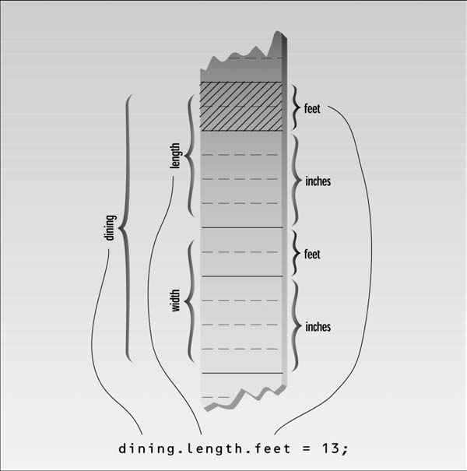
Structure within structure
Accessing Nested Structure Members
dot operator twice to access
the structure members.
Eg- dining.length.feet = 13;
Initializing Nested Structures
Eg.
Room dining = { {13, 6.5}, {10, 0.0}};
Depth of Nesting
In theory, structures can be nested
to any depth.
Eg.
apartment1.laundry_room.washing_machine.width.feet
FIGURE 4.6
Dot operator and nested structures

Slide 13
Structure within structure
#include <iostream>
using namespace std;
struct Distance //English distance
{ int feet;
float inches;
};
struct Room //rectangular area
{
Distance length; //length of rectangle
Distance width; //width of rectangle
};
int main()
{
Room dining; //define a room
dining.length.feet = 13; //assign values to room
dining.length.inches = 6.5;
dining.width.feet = 10;
dining.width.inches = 0.0;
//convert length & width
float l = dining.length.feet + dining.length.inches/12;
float w = dining.width.feet + dining.width.inches/12;
//find area and display it
cout << “Dining room area is “ << l * w
<< “ square feet\n” ;
return 0;}

Slide 14
A Card Game Example
int main()
{
card temp, chosen, prize; //define cards
int position;
card card1 = { 7, clubs }; //initialize card1
cout << “Card 1 is the 7 of clubs\n”;
card card2 = { jack, hearts }; //initialize card2
cout << “Card 2 is the jack of hearts\n”;
card card3 = { ace, spades }; //initialize card3
cout << “Card 3 is the ace of spades\n”;
prize = card3; //copy this card, to remember it
cout << “I’m swapping card 1 and card 3\n”;
temp = card3; card3 = card1; card1 = temp;
cout << “I’m swapping card 2 and card 3\n”;
temp = card3; card3 = card2; card2 = temp;
cout << “I’m swapping card 1 and card 2\n”;
temp = card2; card2 = card1; card1 = temp;
cout << “Now, where (1, 2, or 3) is the ace of spades? “;
cin >> position;
switch (position)
{case 1: chosen = card1; break;
case 2: chosen = card2; break;
case 3: chosen = card3; break;}
if(chosen.number == prize.number && // compare cards
chosen.suit == prize.suit)
cout << “That’s right! You win!\n”;
else
cout << “Sorry. You lose.\n”;
return 0;
}
// cards.cpp
// demonstrates structures using playing cards
#include <iostream>
using namespace std;
const int clubs = 0; //suits
const int diamonds = 1;
const int hearts = 2;
const int spades = 3;
const int jack = 11; //face cards
const int queen = 12;
const int king = 13;
const int ace = 14;
struct card
{
int number; //2 to 10, jack, queen, king, ace
int suit; //clubs, diamonds, hearts, spades
};

Slide 15
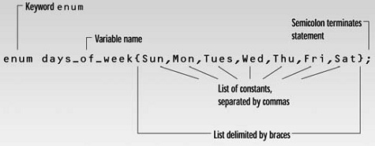
Enumerations (programmer-defined type)
An enum declaration defines the set of all names that will be permissible values of the type/list of all possible values.
Use standard arithmetic operators on enum type.
Enumerations are treated internally as integers.

Slide 16
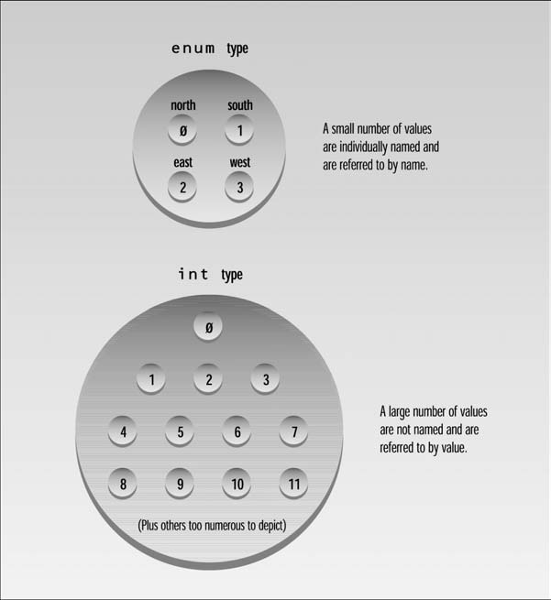
Enumerations
FIGURE 4.9
Usage of ints and enums.

Slide 17
Days of the Week
#include <iostream>
using namespace std;
//specify enum type
enum days_of_week { Sun, Mon, Tue, Wed, Thu, Fri, Sat };
int main()
{
days_of_week day1, day2; //define variables
//of type days_of_week
day1 = Mon; //give values to
day2 = Thu; //variables
int diff = day2 - day1; //can do integer arithmetic
cout << “Days between = “ << diff << endl;
if(day1 < day2) //can do comparisons
cout << “day1 comes before day2\n”;
return 0;
}

Slide 18
Enumerations Example
// Page 152
// wdcount.cpp
#include <iostream>
using namespace std;
#include <conio.h> //for getche()
enum itsaWord { NO, YES }; //NO=0, YES=1
int main()
{
itsaWord isWord = NO; //YES when in a word,
//NO when in whitespace
char ch = ‘a’; //character read from keyboard
int wordcount = 0; //number of words read
cout << “Enter a phrase:\n”;
do {
ch = getche(); //get character
if(ch==’ ‘ || ch==’\r’) //if white space,
{
if( isWord == YES ) //and doing a word,
{ //then it’s end of word
wordcount++; //count the word
isWord = NO; //reset flag
}
} //otherwise, it’s
else //normal character
if( isWord == NO ) //if start of word,
isWord = YES; //then set flag
} while( ch != ‘\r’ ); //quit on Enter key
cout << “\n---Word count is “ << wordcount << “---\n”;
return 0;
}

Slide 19
Other Examples
enum months { Jan, Feb, Mar, Apr, May, Jun,Jul, Aug, Sep, Oct,
Nov, Dec };
enum switch { off, on };
enum meridian { am, pm };
enum chess { pawn, knight, bishop, rook, queen, king };
enum coins { penny, nickel, dime, quarter, half-dollar, dollar };

Slide 20
Exercises
Page 158
Ex 1 to 12

